Slide 1
TI Training Learnings
Samir Paul
A0507124
May 15 – May 26

Slide 2

Unix: Commands link
ls lists files folders
ls –l lists files in the 'long format'
ls –a lists all files, including the ones whose filenames begin in a dot
mv filename1 filename2 move filename1 to filename2
cp filename1 filename2 copy
rm filename removes a file. rm –i asks for confirmation before deleting
diff filename1 filename2 compares files
wc filename count of lines, words, charecters
chmod options filename chmod o+r filename readable for everyone, chmod o-r filename unreadable for others again
gzip filename compresses files
gunzip filename uncompresses files compressed by gzip
gzcat filename look at a gzipped file without gunzip it

Slide 3
mkdir dirname
cd dirname
pwd
ff --- find files anywhere on the system
grep string filename
who
whoami
ps -u username
kill PID
touch creates empty file
rm filename
sort filename print list in lexicographical order
man command_name provides reference on commands
clear
history

Slide 4
chmod [options] [mode] [File_name]
chmod [options] [mode] [File_name]
groups shows the groups I have membership
chmod [options] [mode] [File_name] Learn more
chown change file/directory ownership Learn more
cat>filename create a file with some contents
Cat filename open a file in notepad
Head Print first 10 lines
Tail
wget – download files from remote servers, HTTP/HTTPS and FTP
set: to check details.
Echo string eg. echo “Samir is an intern at TI” prints this string
x = 10
echo the value of x is $x

Slide 5
alias unalias
set unset
ls all ls commands: tutorialspoint.com/unix_commands/ls.htm
gvim
More all more commands: ibm.com/docs/en/aix/7.2?topic=m-more-command
w --- tells who's logged in, and what they're doing
All Unix commands of training: https://github.com/samirti/unix/raw/main/unix-training.docx

Slide 6
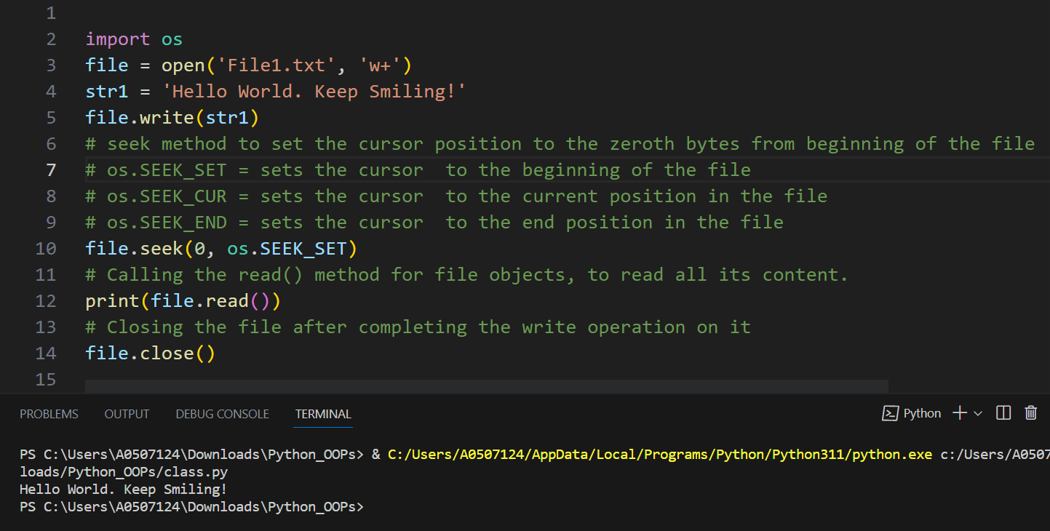
Python:
Modifying a File on the Disk:
w+ mode to modify the file

Slide 7
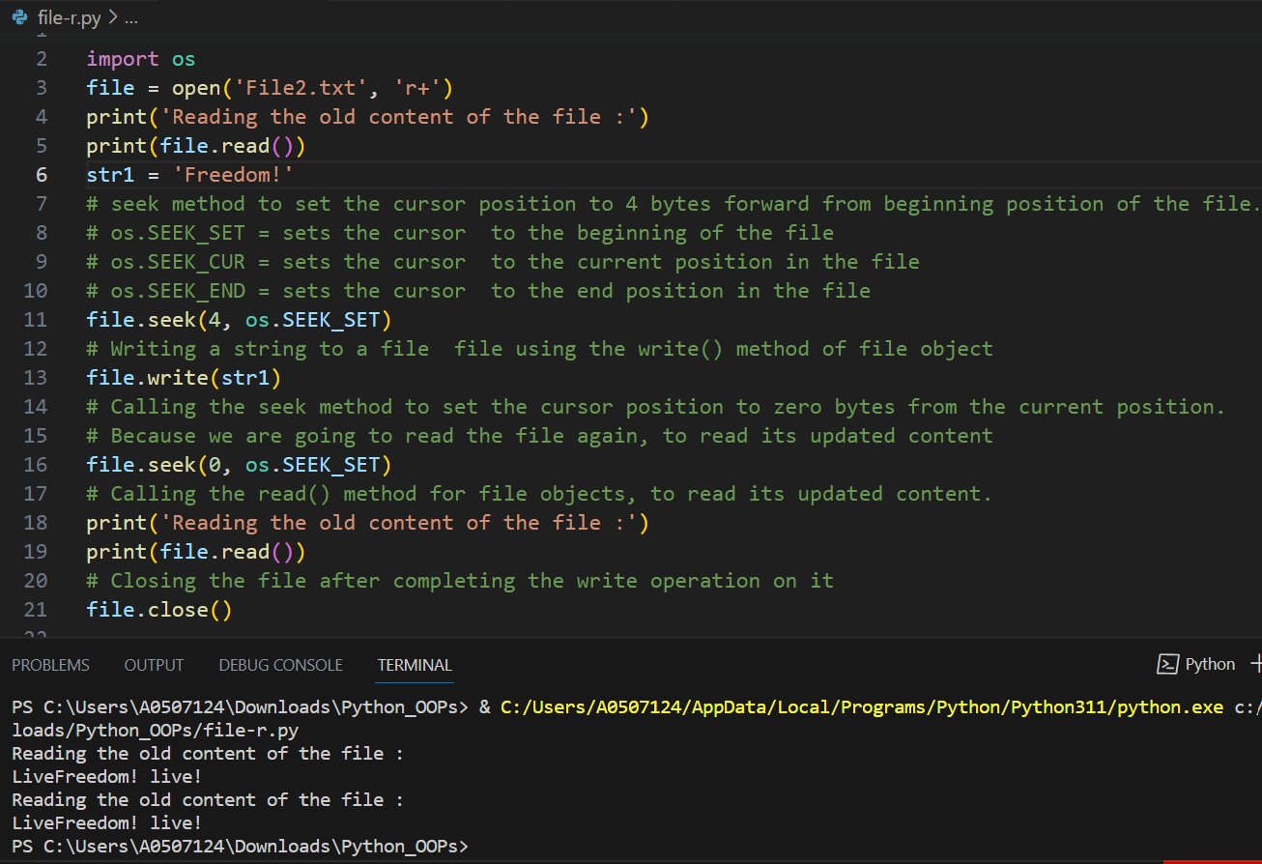
r+ mode to modify the file

Slide 8
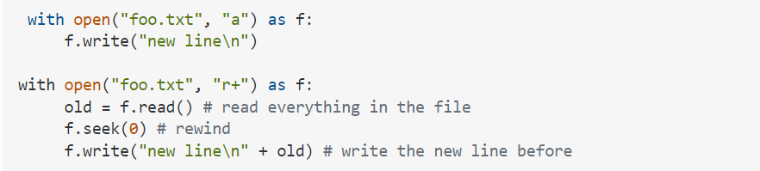
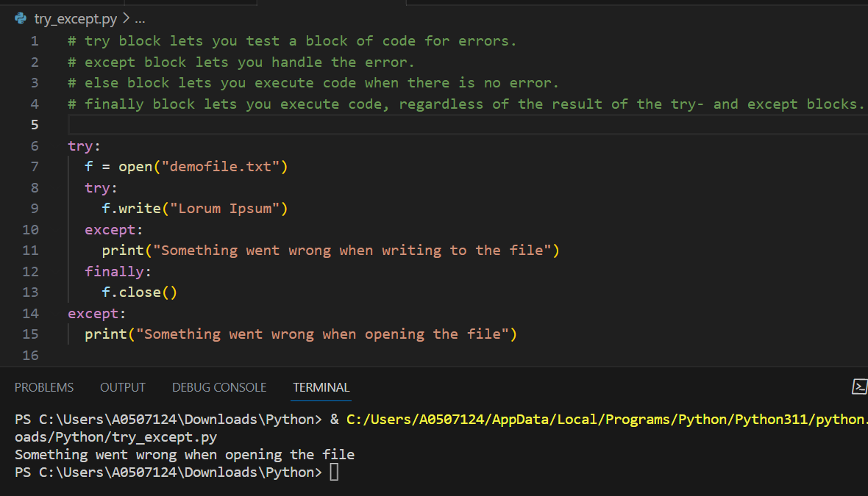
Try Except

Slide 9
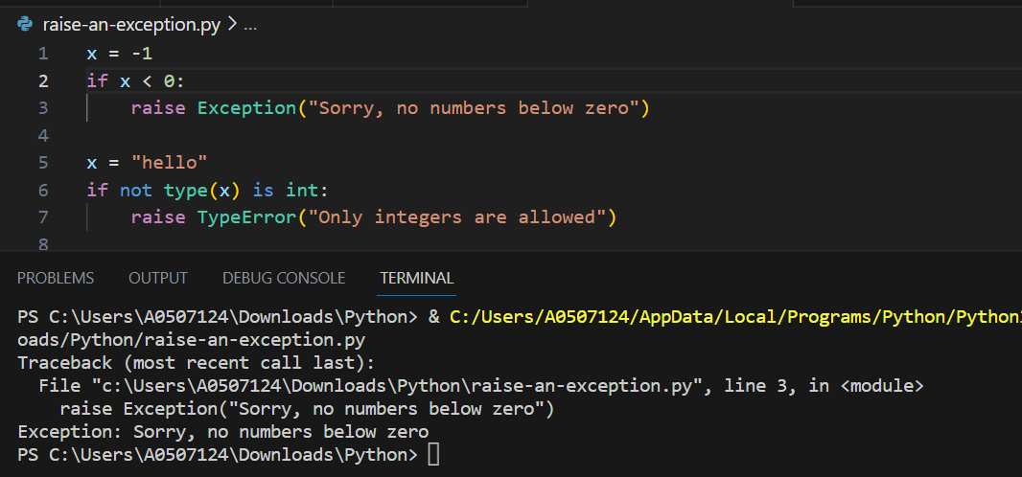
Raise an exception

Slide 10
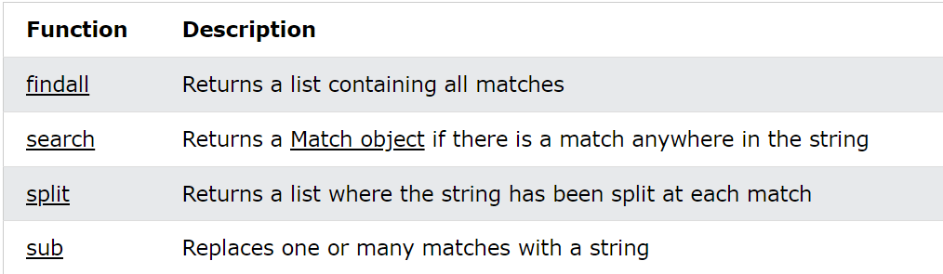
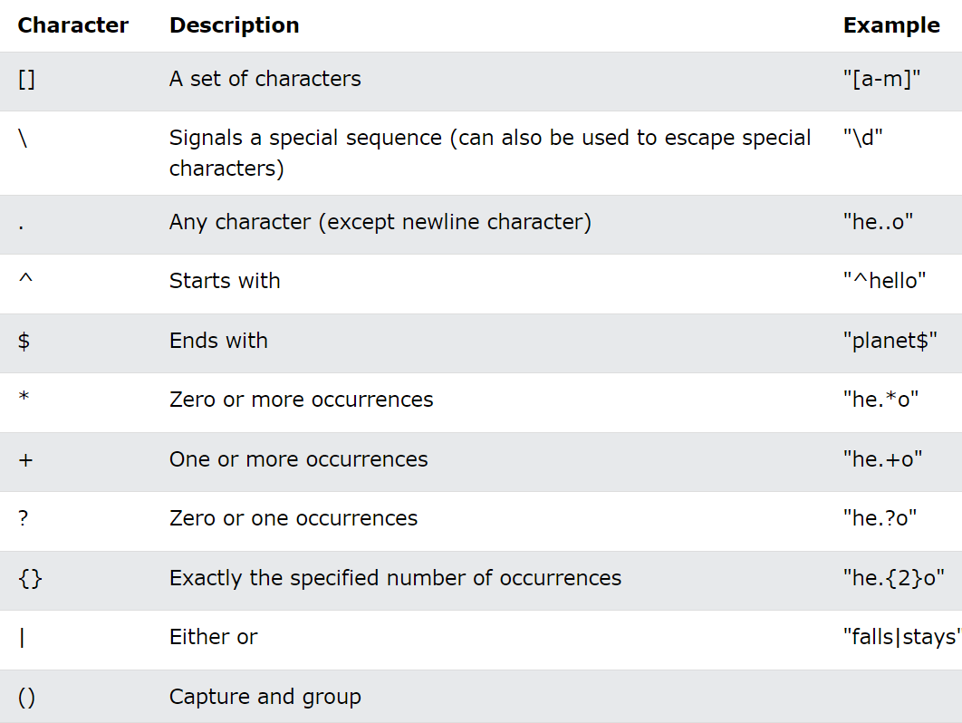
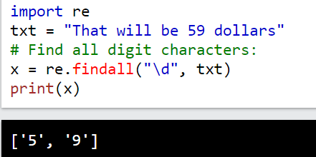
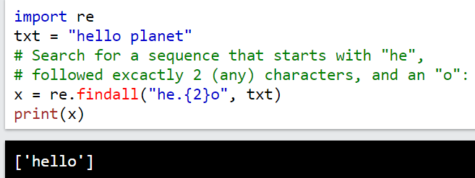
RegEx Module

Slide 11
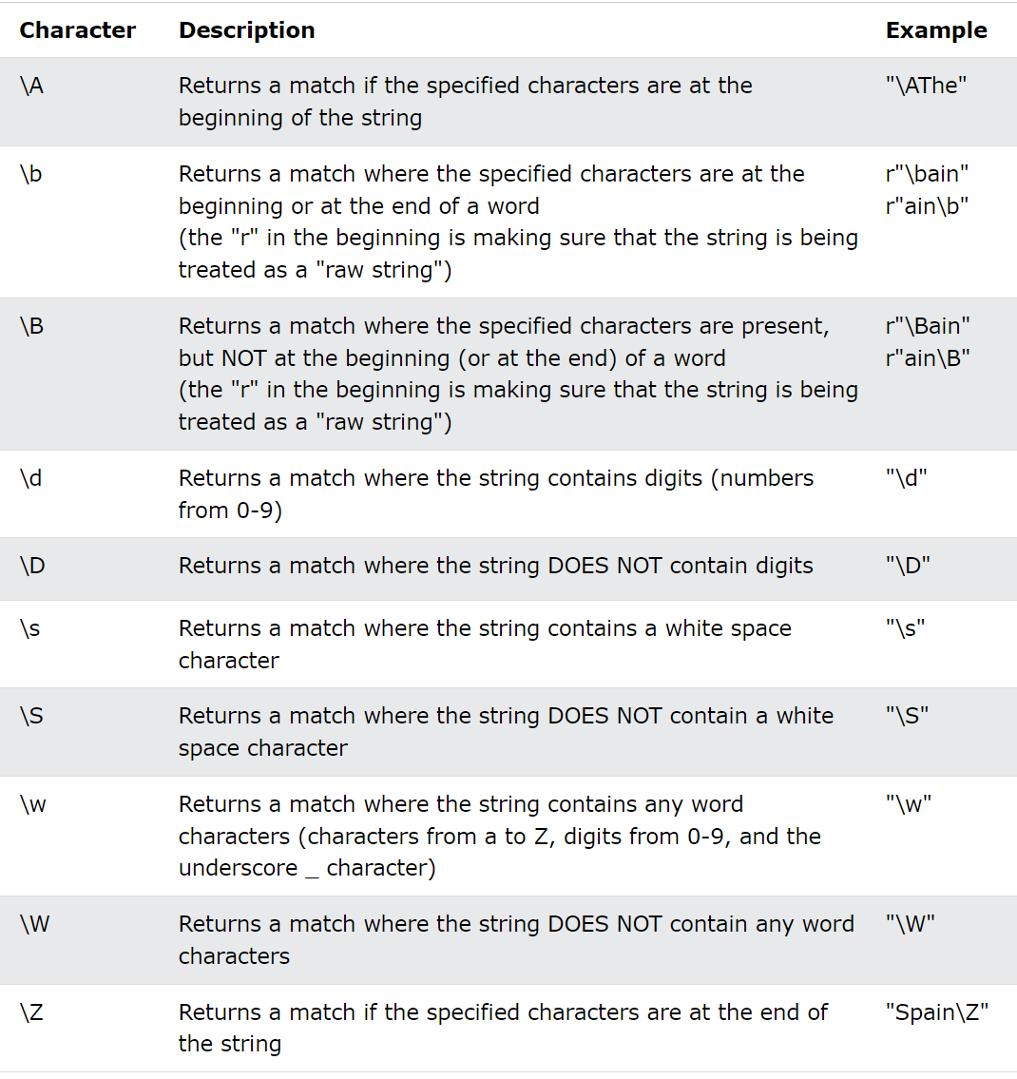
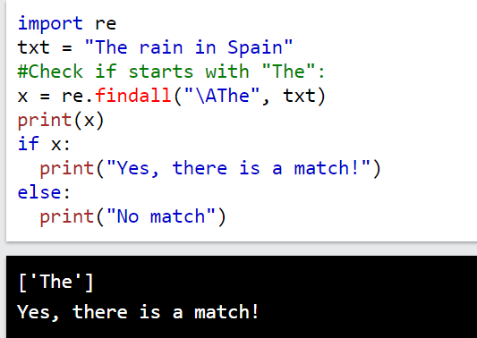
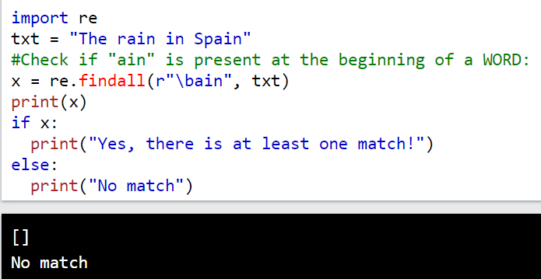
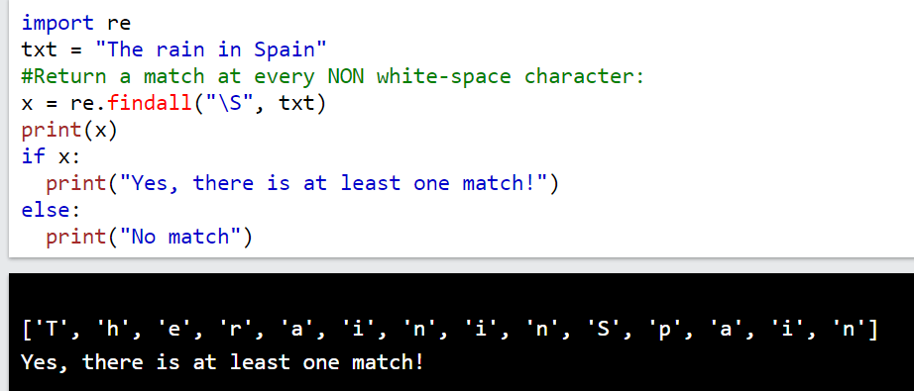

Slide 12
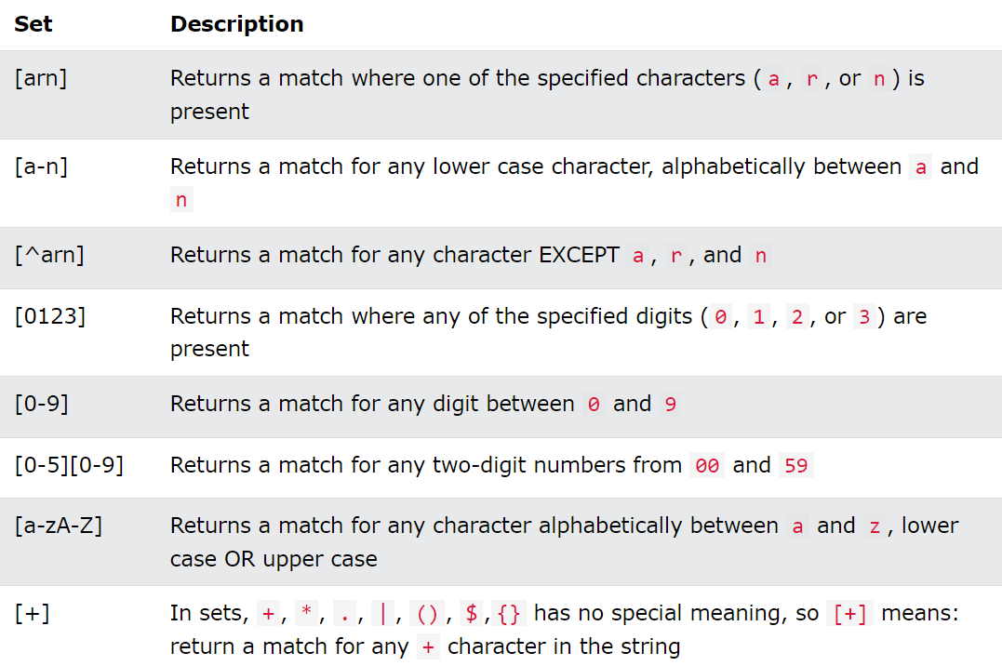
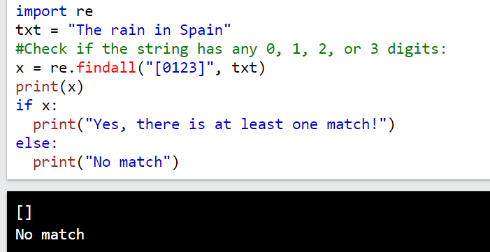
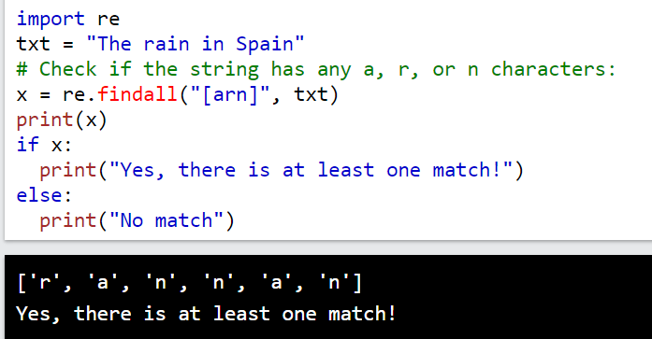
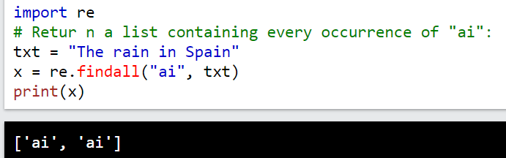
findall() Function

Slide 13
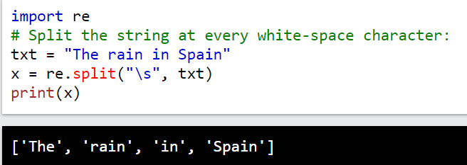
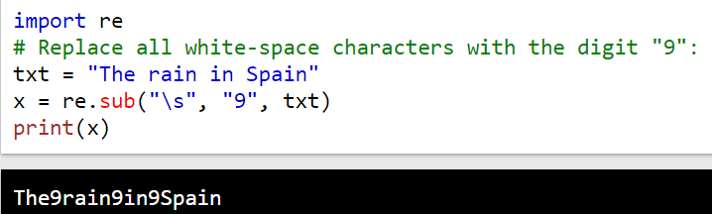
split() Function
sub() Function

Slide 14
Python Object-Oriented Programming
Python Object Oriented Programming by Joe Marini course
C:\Users\A0507124\Downloads\Python_Object_Oriented_Programming
https://github.com/samirti/python/raw/main/Python_Object_Oriented_Programming.zip

Slide 15
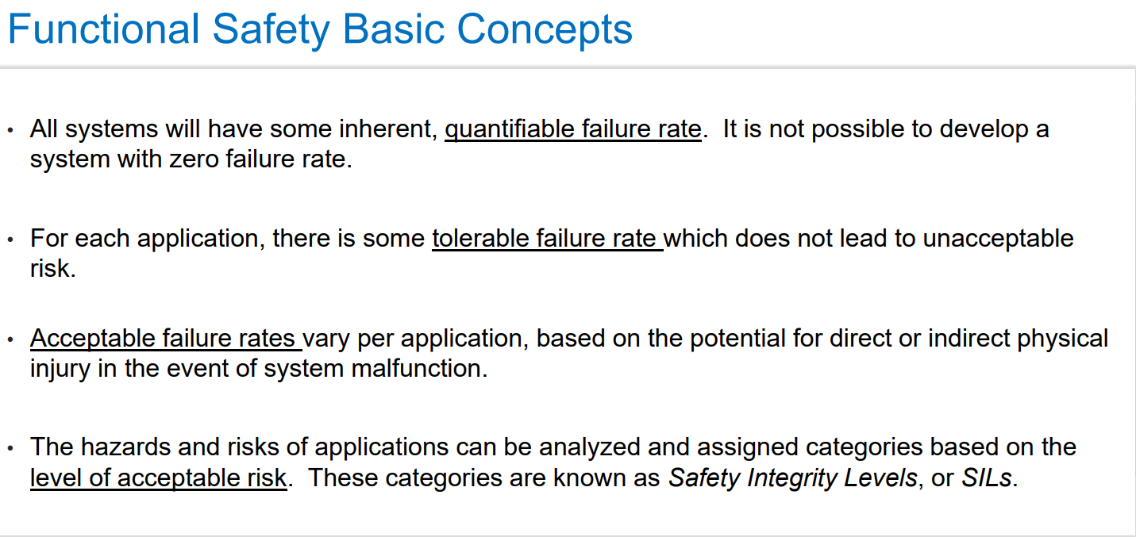

Slide 16
ISO 26262 Functional Safety Standard
ISO 26262 addresses the need for an automotive-specific international standard that focuses on safety-critical components.
ISO 26262 is a derivative of IEC 61508, the generic functional safety standard for electrical and electronic (E/E) systems.
ISO 26262 uses a system of steps to manage functional safety and regulate product development on a system, hardware, and software level. It details how to assign an acceptable risk level to a system or component and documents the overall testing process.
Key Components:
Automotive Safety Lifecycle(management, development, production, operation, service, decommissioning).
Automotive Safety Integrity Levels, ASILs (specific risk-based approach for determining risk classes)

Slide 17
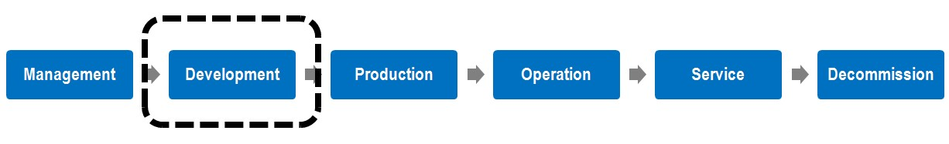
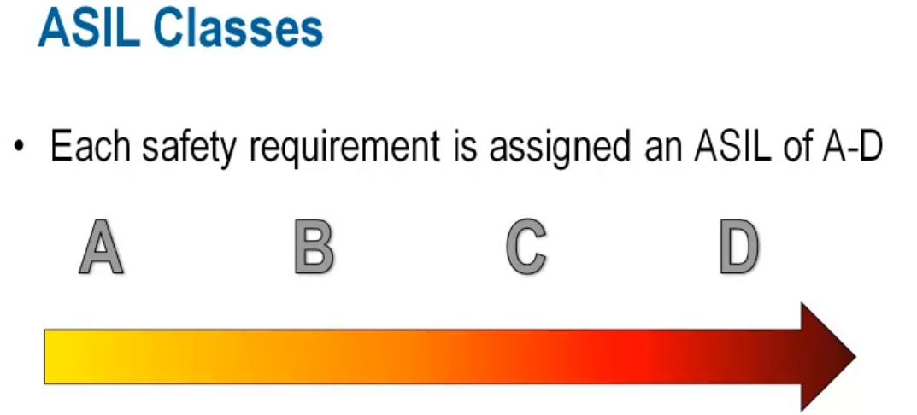
Automotive Safety Lifecycle
The ISO 26262 automotive safety lifecycle describes the entire production lifecycle.
Automotive Safety Integrity Level (ASIL)
Automotive-specific approach for assigning risk levels. ASIL does not address the technologies
Used in the system it’s totally on the harm to the driver and other road users.
least safety most safety

Slide 18
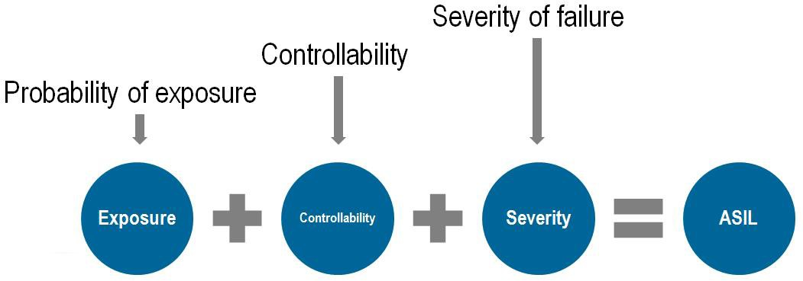
Qualification of Hardware Components
Hardware qualification has two main objectives: to show how the part fits into the overall system and to assess failure modes.
Basic Parts: Resistors and Diodes.
Intermediate parts or components: Sensors, Actuators, and ASICs with dedicated functionality.
Complex components: Microprocessor, Microcontroller, DSP, and accelerator.
Qualification of Software Components
Qualifying software components involves activities such as defining functional requirements, resource usage, and predicting software behavior in failure and overload situations. Software errors such as runtime and data errors are analyzed and addressed throughout the design process.

Slide 19
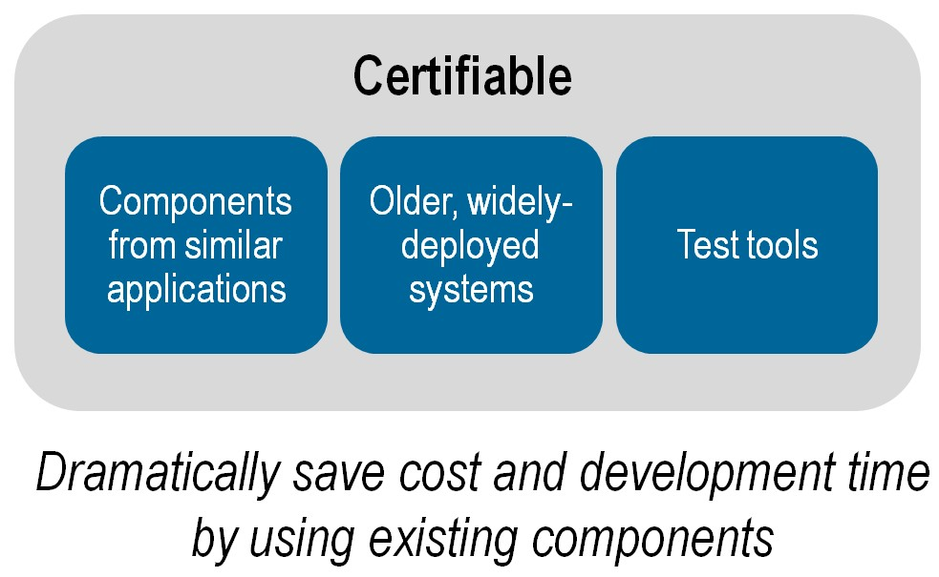
Reliable systems that remain unchanged and have been used for a long time are certifiable with ISO 26262. The combination of certifiable components from similar applications and from older, widely-deployed applications greatly reduces the overall system complexity. We can use those components to save costs.

Slide 20
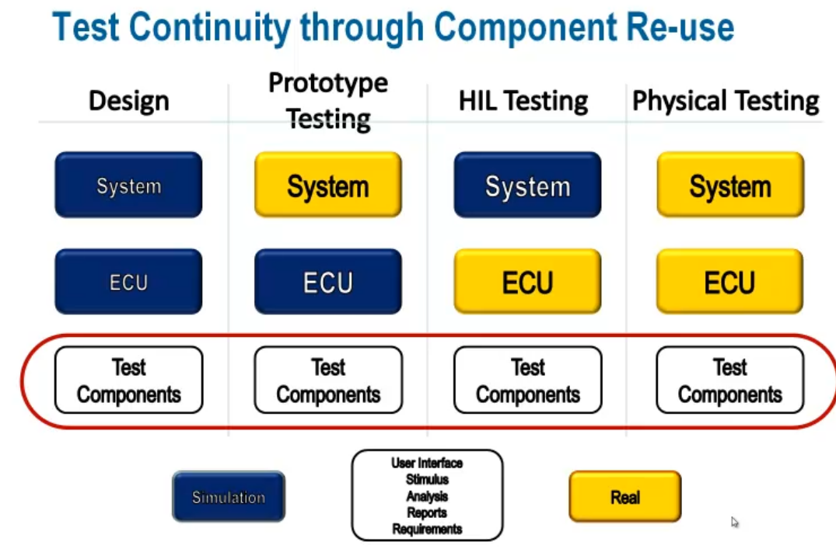
Test components reuse across all testing applications can increase consistency and efficiency throughout the process.

Slide 21
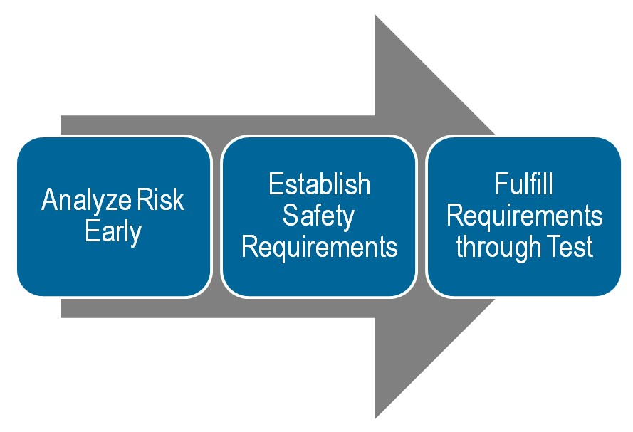
Applying ISO26262 to Current Processes
It is important for companies looking to implement ISO26262 to understand that the goal is to analyze risk early in the development process, establish the appropriate safety requirements, and fulfill these requirements by testing during development.

Slide 22
It is estimated that the cost of a failure decreases by 10 times when the error is caught in production instead of in the field and decreases 10 times again if it is caught in design instead of production.
Tool Confidence Level (TCL):
The possibility of a malfunctioning software tool and its erroneous output can lead to the violation of any safety requirement allocated to the safety-related item or element to be developed.
The probability of preventing or detecting such errors in its output.
Software Tool Classification Analysis:
Software Tool Classification Analysis (STCA) is to determine the Tool’s Confidence Level.
There are two main components that determine the TCL: Tool Impact (TI) and Tool Error Detection (TD). Based on these two components, the appropriate TCL is chosen.

Slide 23
ISO 26262 Safety Mechanism Insertion And Validation An automated workflow using safety synthesis and formal verification can help address random faults with safety mechanisms.
Automotive ICs have become too large and complex to expect a human to fully comprehend the safety mechanisms required to protect all possible failures. An automated workflow must be deployed to assist experts in addressing random faults. An efficient approach is to use safety synthesis and formal verification to incorporate safety mechanisms into the design. This is best to be done at the register transfer level (RTL), where functional verification can be performed efficiently.
The process can consist of these major steps:

Slide 24
Safety Exploration:
The goal of safety exploration is to identify optimal safety architecture and safety mechanisms. Safety mechanisms come in a variety of flavors, each with its own level of effectiveness in detecting random hardware faults. During safety exploration, a series of “what-if” scenarios are performed to understand the impact of different safety mechanisms on the design, especially with respect to power, area, performance, safety metrics, and diagnostic coverage. We recommend this exploration be done without modifying the design so that simultaneous analyses can be performed quickly and efficiently. If this is performed early in the design process, safety exploration will help design teams meet the safety targets successfully after insertion and verification.

Slide 25
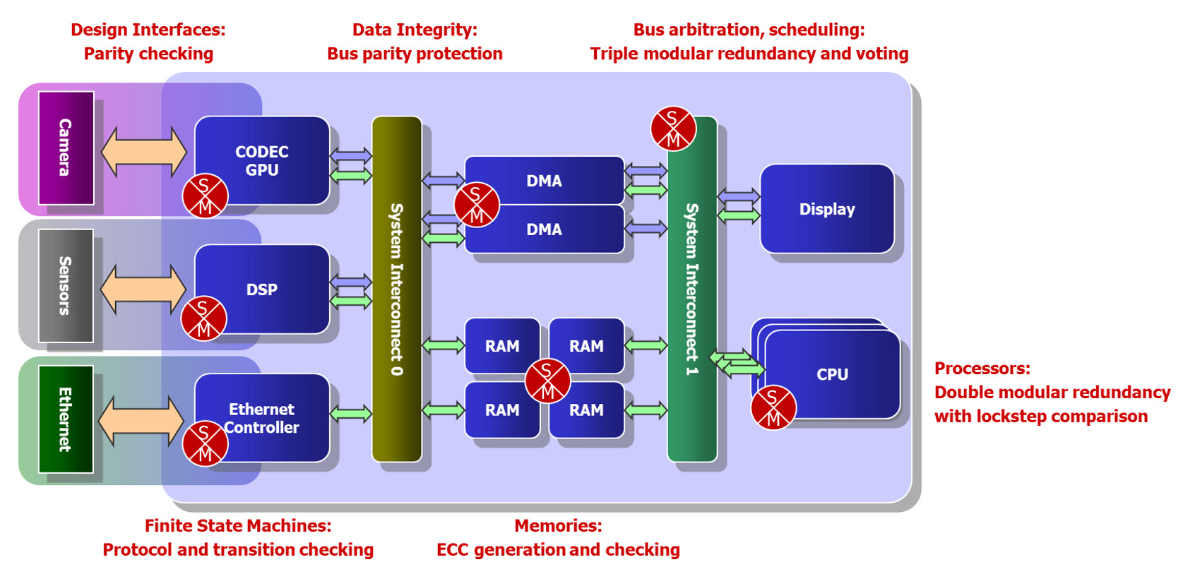
Safety Mechanism Insertion:
Modifying a legacy design to introduce safety mechanisms. Use safety synthesis to introduce safety mechanisms that have the right tradeoff for the RTL structures. To create a safety architecture for legacy designs, safety synthesis introduces two types of safety mechanisms automatically. One is used at the register level, and the other is used at the module level.

Slide 26
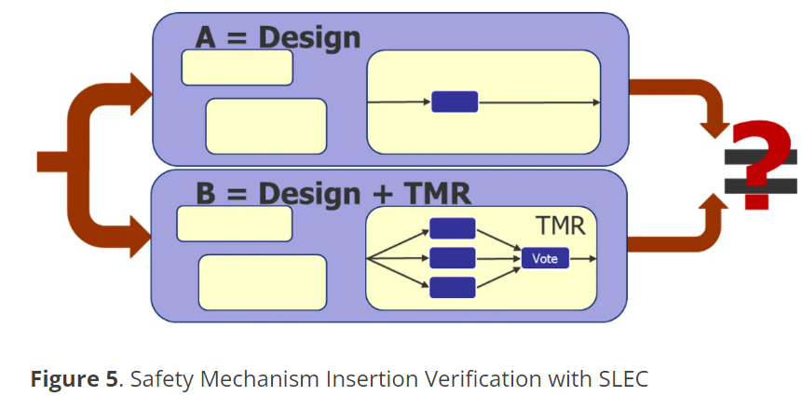
Design Change Validation:
Validate the design changes with formal verification. Sequential Logic Equivalence Checking (SLEC) formally verifies that two designs are functionally equivalent using formal verification technology.
Safety Mechanism Insertion: ensures that the functionality of the original design is not changed by the addition of the safety mechanisms
Safety Mechanism Operation: ensures that the inserted functional safety mechanisms are working as

Slide 27
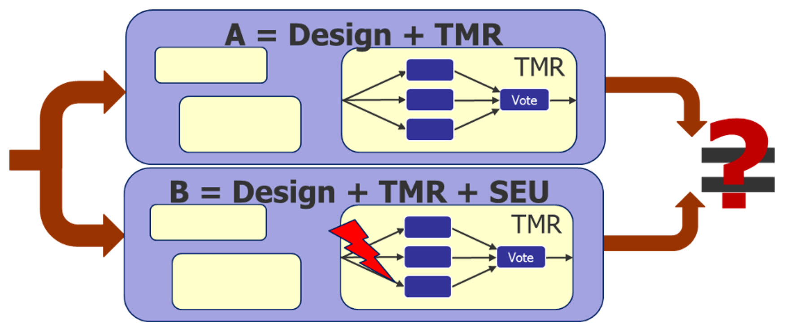
Formal Fault Injection:
Perform formal fault injection to measure the diagnostic coverage.
By comparing a fault-injected design with a copy of itself without faults, the formal tool checks if there is any possible way for a fault to either escape to the outputs or go undetected by the safety mechanism.
see if the fault is propagated,
masked, or detected by the
safety mechanisms.

Slide 28
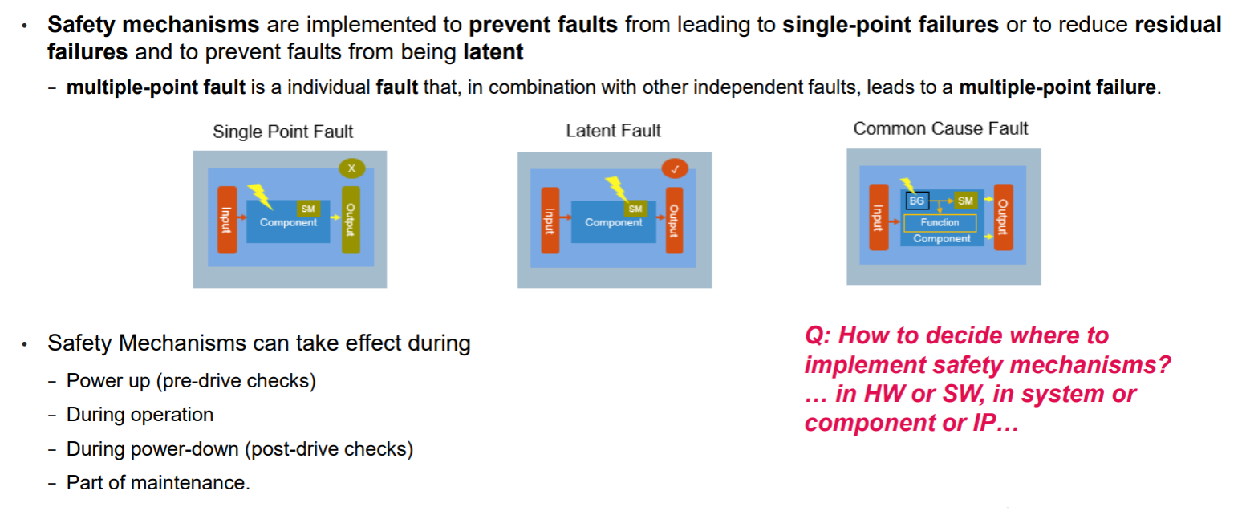

Slide 29
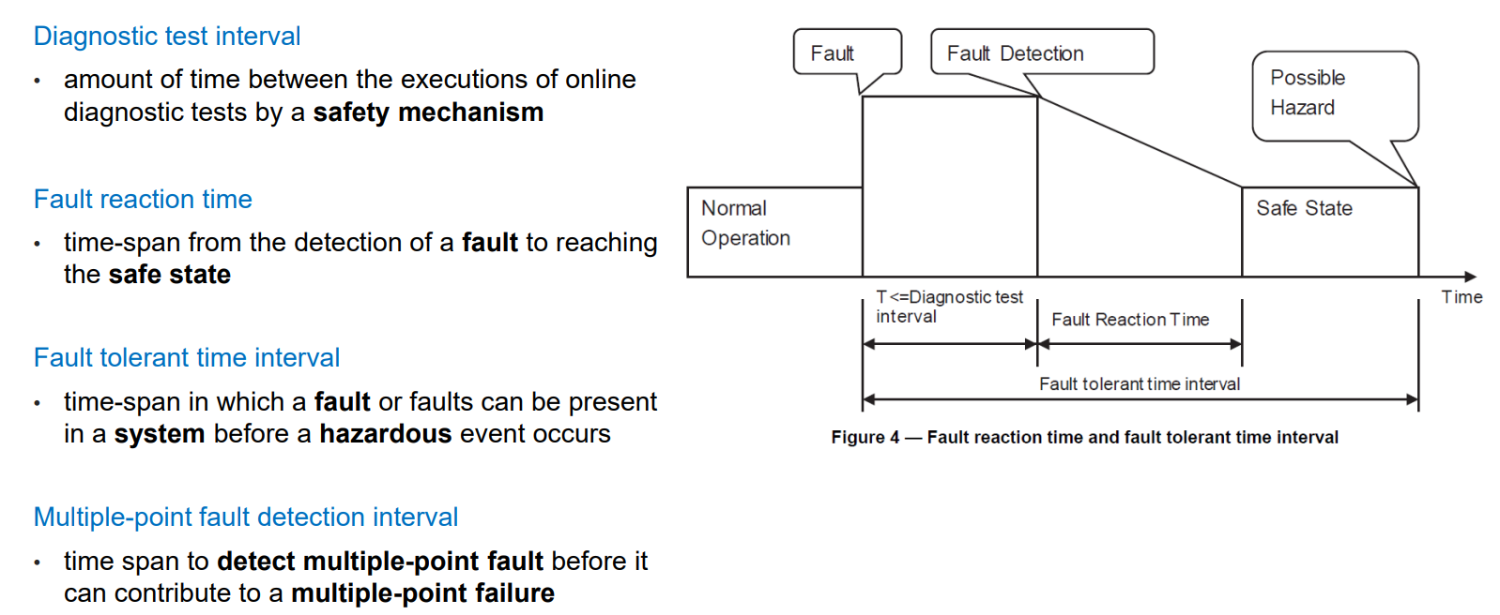
Fault Detection & Reaction Times

Slide 30
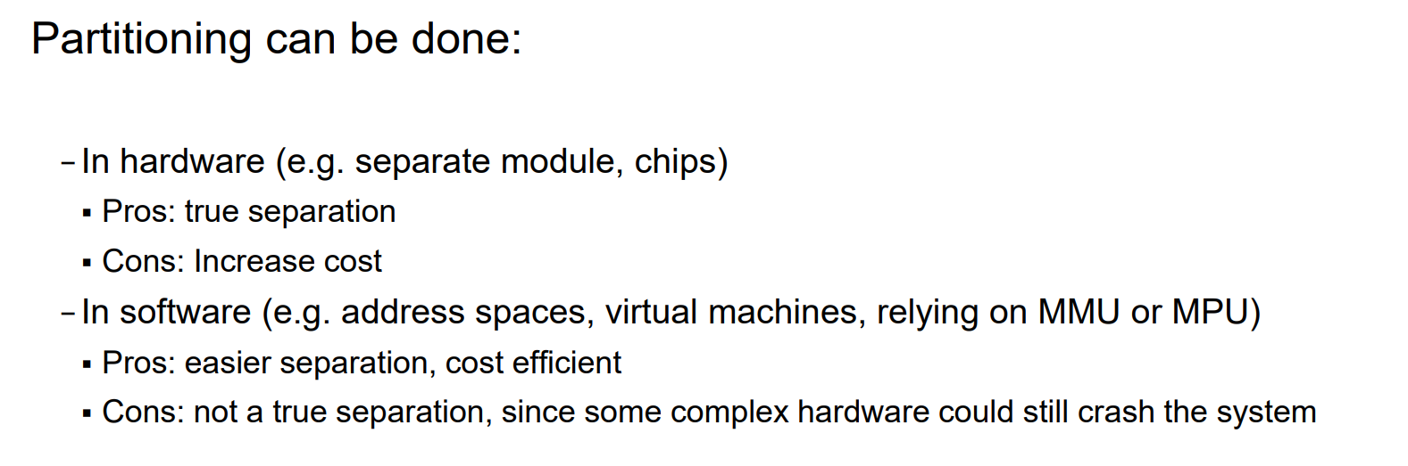
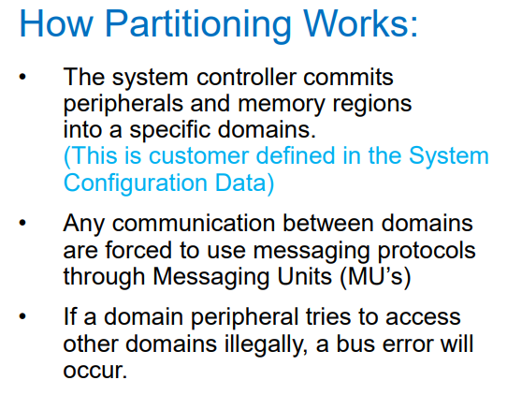
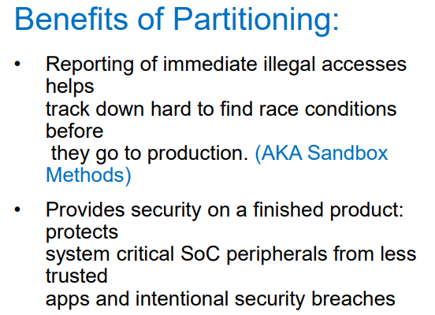
Partitioning A Safety Critical System

Slide 31
FORMAL VERIFICATION AND SIMULATION
Formal verification is an approach to verification that analyzes a design to prove or disprove certain properties.
ex: Verifying a behavioral ALU design using gate-level implementation Usually limited to small designs or verifying certain key properties
A simulation is an approach where we create a model of the design that can be executed on a computer and provide inputs and check that outputs of the model match the expectations.
Simulation has several advantages like excellent controllability and observability.
Simulation has also several disadvantages and perhaps the most important one is it's extremely slow compared to execution on physical implementation(emulation).
EMULATION
"Emulation is the technique whereby the design is transformed into an implementation capable of being executed on special purpose hardware” Emulator is a physical device onto which a system can be mapped relatively quickly (in hours or days) and which can be placed into the system's real eventual environment.
Emulator has a number of blocks capable of taking on a function (such as tens of FPGAs) and a programmable interconnect. Emulator also has a software toolchain that configures the interconnect and provides runtime env that makes the emulator look similar to the simulator
An emulator can either be connected to a testbench or another part of the circuit running in a logic simulator. This is called co-emulation or simulation acceleration.
These support designers to debug tasks such as stopping execution and viewing the internal values.
Since an emulator is a physical implementation, it is typically much faster than a simulation.
Since the environment isn't modeled here, an incomplete environment is not a problem as well.
Field Programmable Gate Arrays (FPGAs) are integrated circuits often sold off the shelf. They're referred to as 'field programmable' because they provide customers the ability to reconfigure the hardware to meet specific use case requirements after the manufacturing process.

Slide 32
Functional verification:
Functional verification is the process of demonstrating the functional correctness of an RTL design with respect to the design specifications. Functional verification attempts to check whether the proposed design is doing what it is intended to do. This is a complex task and takes the majority of time and effort in most large electronic system design projects. It is imperative that the design is functionally verified and any potential bug is eliminated at an early stage.
Validation:
While pre-silicon verification runs the test cases on the design on the simulator, post-silicon validation is executed on a few initial hardware prototypes of the design on the silicon chip in a real environment. This process captures the bugs that are escaped during the RTL Design Verification phase. Validation also checks for the correctness of the design but on the real hardware in an actual working ambiance.

Slide 33
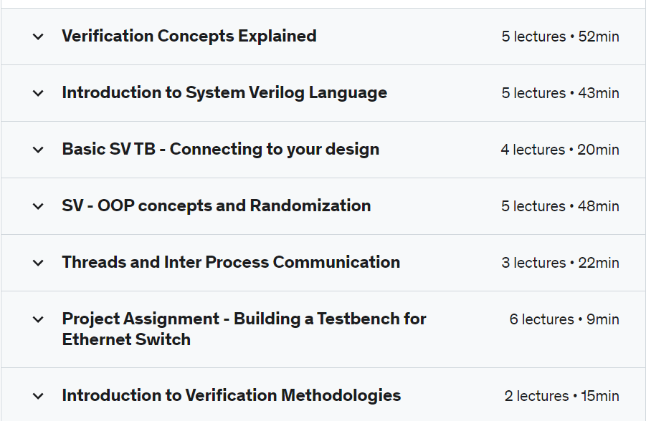
SOC Verification using SystemVerilog
https://www.udemy.com/course/soc-verification-systemverilog/

Slide 34
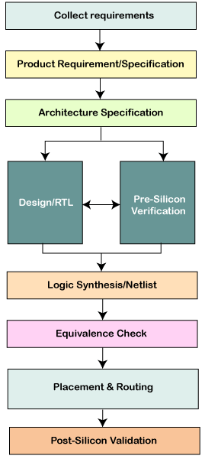
Design Flow

